Slide 1
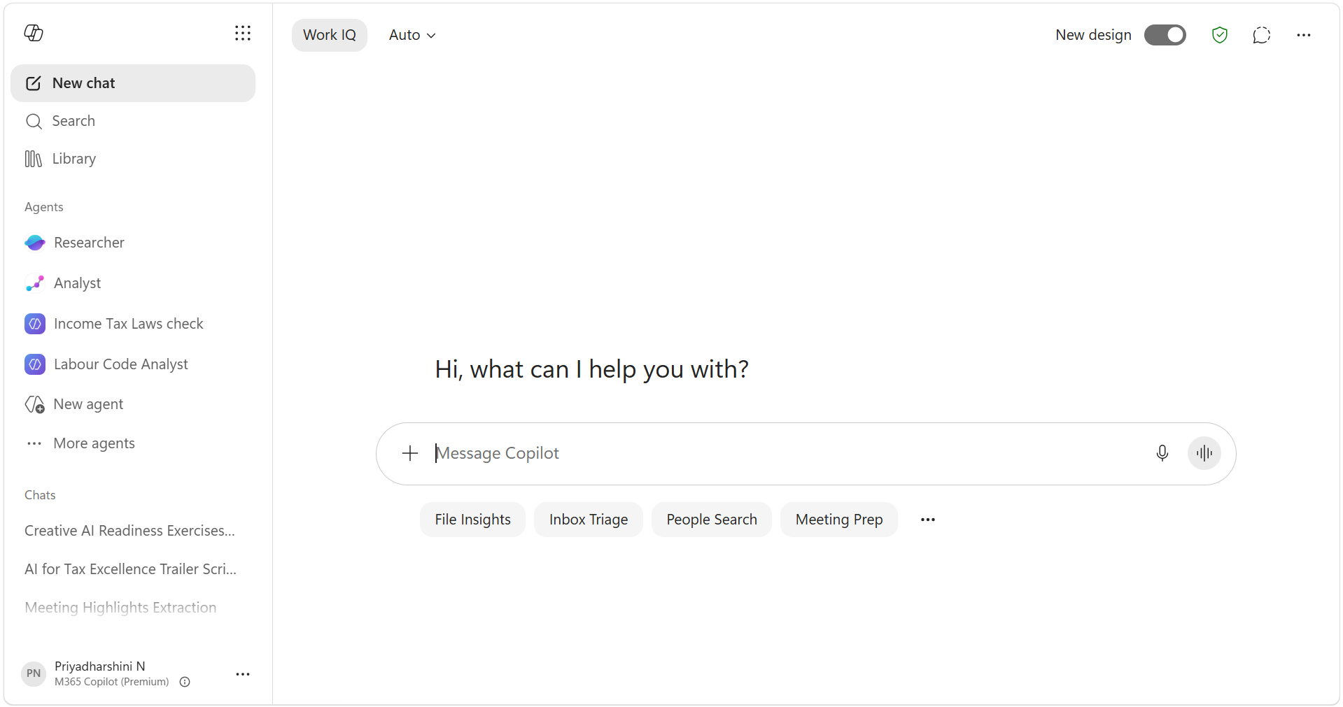
Start a new chat
Finds information quickly
Returns files, emails, meetings, people
Best when you know you're looking for something
Acts like an AI-powered search engine
Your central hub for all Copilot-generated content, such as Pages, images, infographics, and items shared with you.
Performs deep, multi-step research across your work data and the web to deliver a structured, source-cited report.
Analyzes data, identifies patterns, and turns raw information into insights, forecasts, and visualizations. It thinks like a skilled data scientist, so you can go from raw data to insights in minutes.

Slide 2
Automatically selects the most suitable LLM and reasoning level for your task.
New Design with same capabilities
Start a temporary chat
The difference between generic AI and AI that knows your work.
Your gateway to apps, agents, and tools that help Copilot get work done.
Turns ideas into professional content such as images, videos, surveys, pages, and other branded assets using AI.
Build your own AI expert for a specific business need.
Voice chat
Start dictating
All your previous chats are displayed here
Add specific work content like files, meetings, emails, and more for a focused response.
Prompts with a clear goal, context, and references generate the best results.

